Slide 1
Architecture Of Scalable Applications
Ahmed Hesham

Slide 2
What are scalable applications?
Applications that can serve thousands of users concurrently without issues
Scalable apps, can scale up or down resource usage to handle the current users connected
There should be no issues in scaling up or down to be a truly scalable application

Slide 3
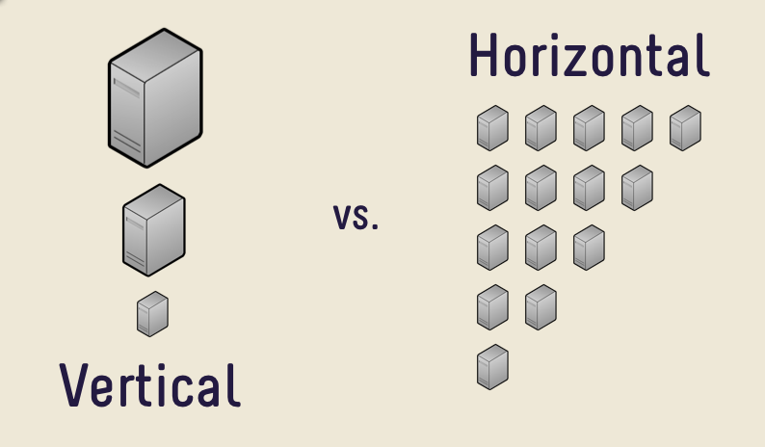
Scalability Types

Slide 4
Why The Need For Scalable Apps?
More people are connected to the internet with the advent of smartphones
Most of population now holds at least one device connected to the internet
There is a limit to vertical scalability

Slide 5

How do apps communicate?

Slide 6

Coupling and Cohesion

Slide 7
Legacy Connections
Previously distributed applications were connected using RPC and RMI protocols to support distribution
RPC and RMI were built on an object architecture and caused the application to be highly coupled

Slide 8
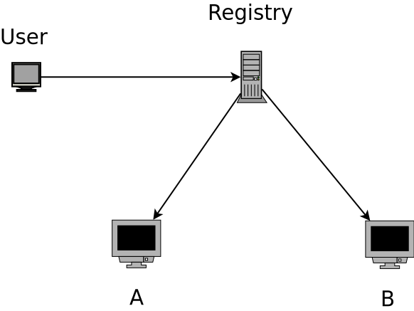
RPC (Remote Procedure Call)
First employed in C/C++, it allowed the remote calling of methods in separate server
A central registry is required to map method location to server
Each new method requires an update to the registry

Slide 9
RPC - continued
To send parameters to the method, they first need to be marshaled (serialized) at the sender side and un-marshaled at the receiver
This adds an over head to the network, if sending large parameters

Slide 10
RMI (Remote Method Invocation)
Similar to RPC except used mainly in the JVM
Adds an abstraction layer over RPC for dealing with object however, data is still serialized on sending

Slide 11
Issue with RPC and RMI
RPC and RMI have a critical flaw, they are both blocking mechanisms
No further requests can be processed until the invocation is processed
Does not support the handling of large number of concurrent users

Slide 12
An Alternative
Ideal solution:
  Handles concurrent users
  Lightweight to allow for scalability (threads not processes)
  Has quantifiable metrics
  Loosely coupled

Slide 13
Birth of Messaging Queues
Messaging Queues, act as buffers to an application
Requests are stored in memory till the application dequeues the request and handles the request
Allows for a more loosely coupled application design
No overhead of marshaling

Slide 14
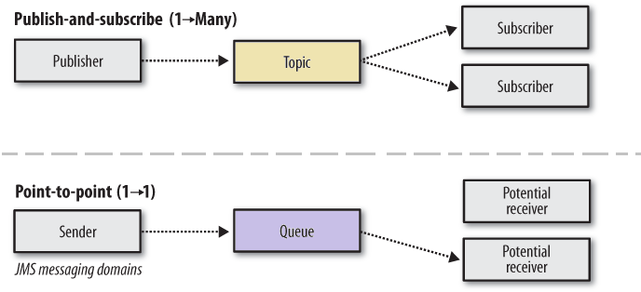
Modes Of Operation
Messaging Queues typically operate in two modes:
  Sender-Receiver
  Publish-Subscribe

Slide 15
Connecting Everything

Slide 16
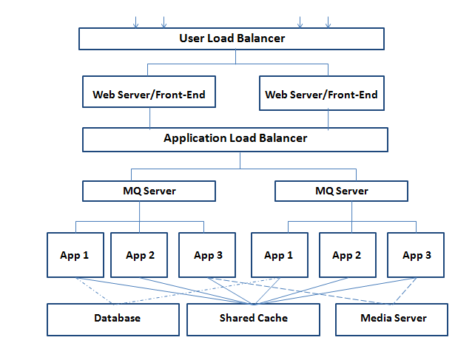
Message Based Architecture Layout

Slide 17
Micro-services
The entire application is broken down into smaller applications grouped by functionality (micro-service)
Allows for easier management of application since it is modular
Micro-service can be easily replicated to handle large number of users easily

Slide 18
Micro-services – continued
Each micro-service can be in a different language as messaging queues abstract communication
Each language has its own use cases and can employed to a specific cause

Slide 19
Designing Scalable Applications
Serverless Architecture: unfeasible to build and manage your own servers worldwide
Self contained dependencies for the application
Packaging (virtualization or containerization)
Remote deployment

Slide 20
Designing Scalable Applications – II
Providing an API to be utilized
Distributed configurations rather than configuration per application

Slide 21
Entry Point

Slide 22
HTTP Server
The HTTP server is the main entry point to the application
Should be able to handle thousands of requests without blocking
Requests are sent through a pipeline to be handled

Slide 23
HTTP Server Pipeline
Front end pages, are built in modules rather than being generated one shot
The HTTP server has a pipeline defined to build these modules in steps
Page is usually rendered before being sent back to the user

Slide 24
Netty
Netty is an asynchronous library for building event driven networks
Built using Java’s non-blocking package entirely
Supports the creation of pipelines

Slide 25
Any Questions?

